Slide 1
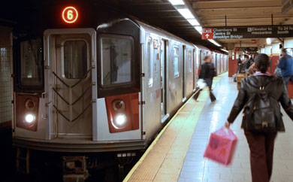
Project Benson
Aaron, Kenneth, Medford, and Dimitri
AKA Team Data Science for Social Justice

Slide 2
Introduction
Proposal/Project Scope:
MTA at a glance
11 million weekly riders, 472 stations
Goals:
Identify stations with highest traffic volume
Location
Gender
Income
Age
Notes:
Medford
Who we are? Name of group / data science consultants, etc.
What do we do? Data Science Consultants, Advance Analytics
Difficulties/Obstacles
Advertising at NYC subways is expensive and labor intensive. Optimizing placements of street teams to yield the biggest signups and turnout is essential to ensuring a successful event at the annual gala
NY MTA at a glance:
Weekly Ridership Numbers: ~11.3 million (5.6 weekday, 5.7 weekend)
across 472 stations with multiple entrance/exits at each station
Goal is to identify stations with highest traffic volume within key demographics: location, gender, income , age
Female, >200K annual income, > 26-31 years old, >50 yr old
identify stations with highest volume of traffic, on days where we saw spikes in traffic compare to baseline. Identify time of day with peak traffic?
stations within proximity to locations of interest: Tech companies: Midtown, Fidi, Flatiron, Dumbo, Chealsea?

Slide 3
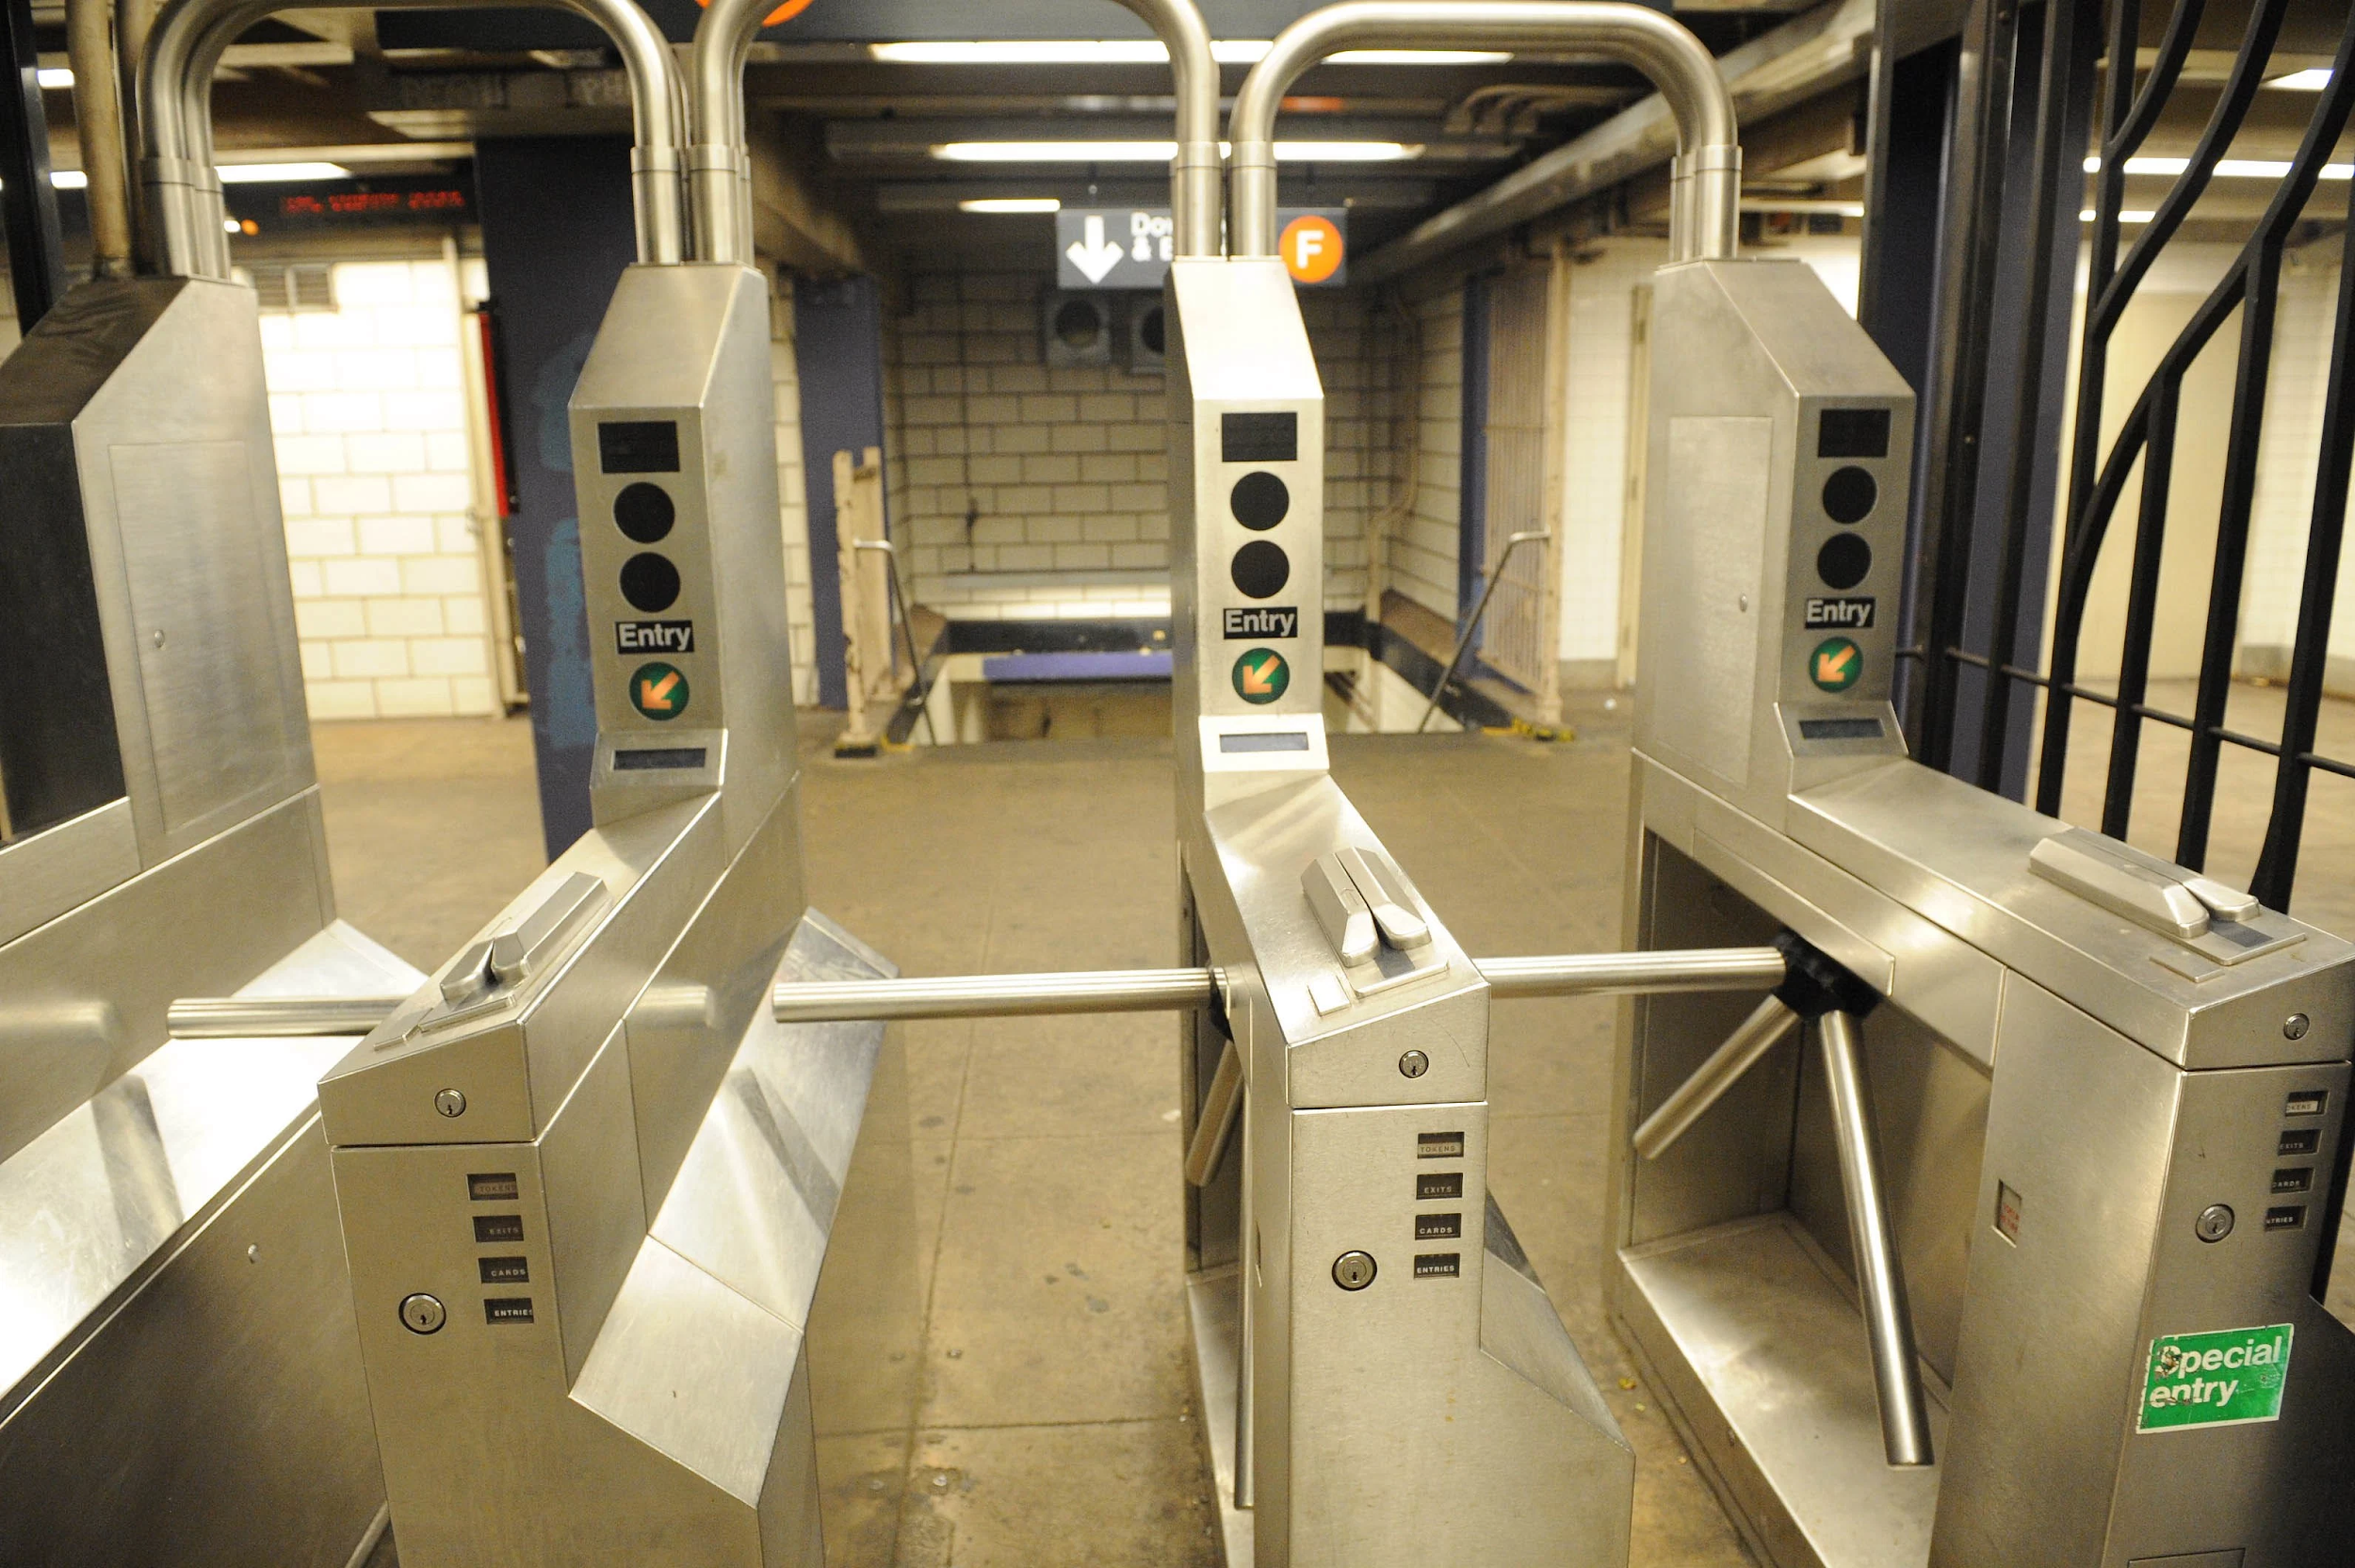
Data Wrangling
Data:
MTA Turnstile Data http://web.mta.info/developers/turnstile.html
IRS & US Census Demographic Data http://zipatlas.com/downloads/
Issues Discovered (EDA)
Reverse Counters
Duplicate & Inconsistent data
Station and Linenames
Time stamps
Notes:
Medford
Inconsistent Data:
Reverse Counters: negative numbers
Linenames: characters were in reverse orders, or missing certain lines, or include extraneous data > gets treated as completely different lines
Timestamps were not in the same 4 hour increments (~7.5%)

Slide 4
Methodologies
2. Demographic-based
Traffic-based

Slide 5
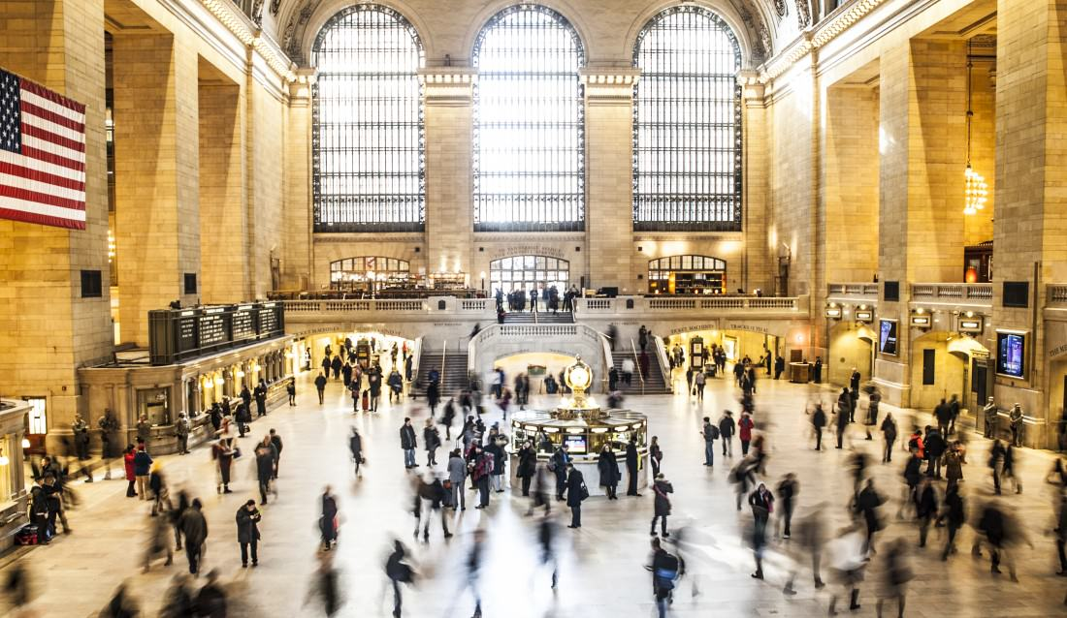
Methodology - pt 1
Rank stations by total traffic
How busy is it?
Time of Day
Day of Week
Holidays?
Notes:
Dimitry

Slide 6
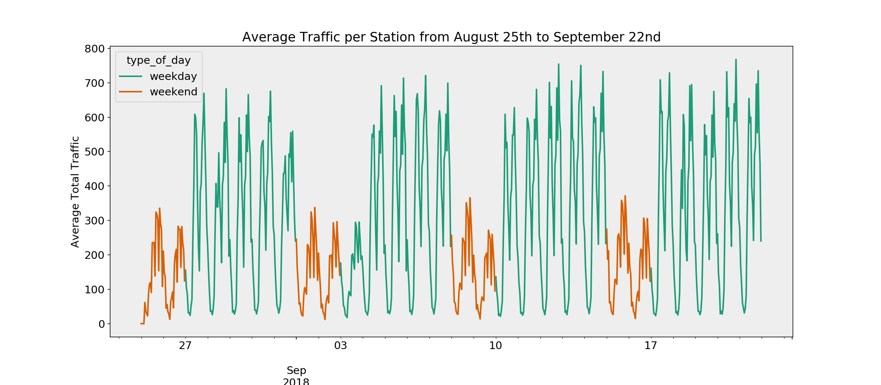
Notes:
Dimitry

Slide 7
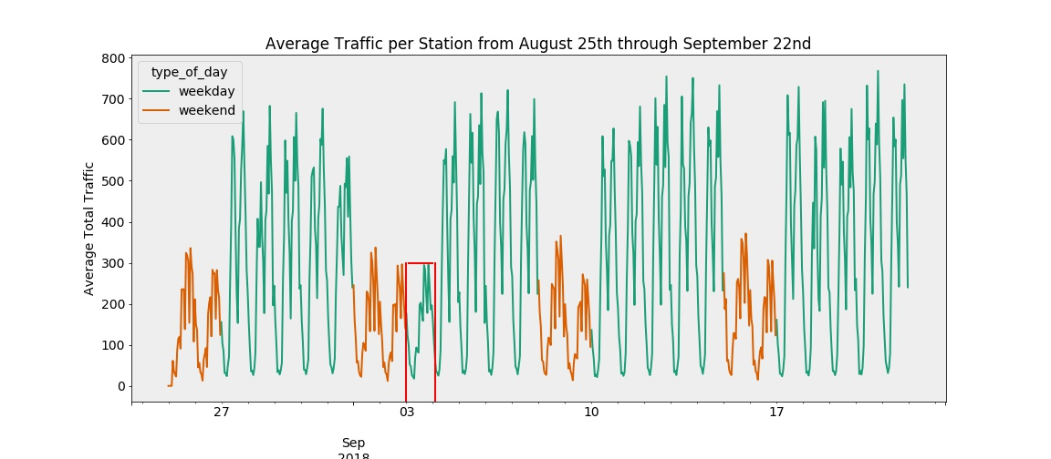
Notes:
Dimitry

Slide 8
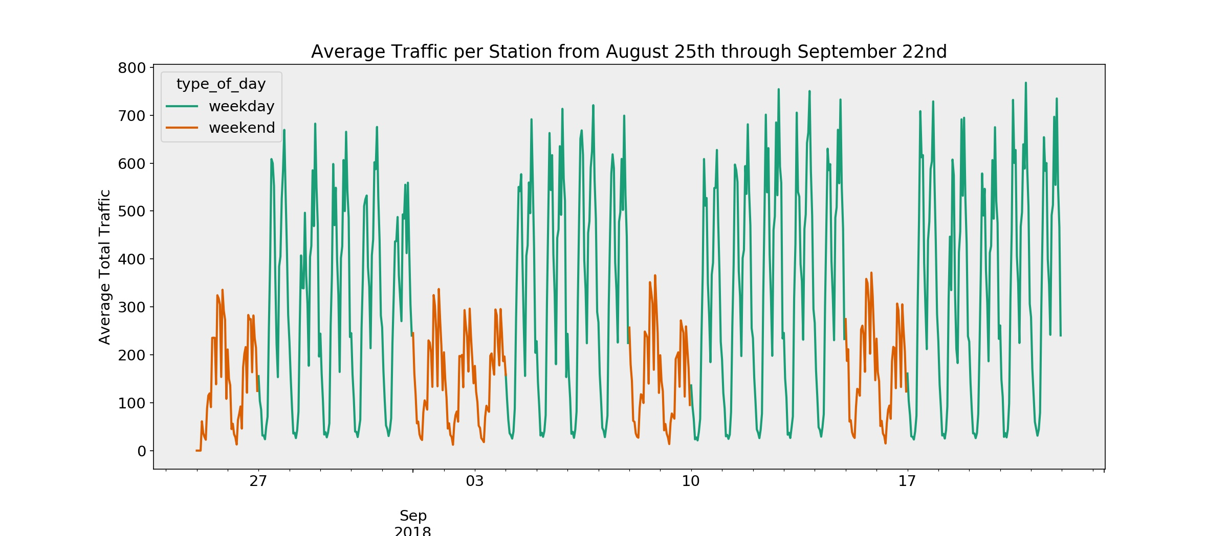
Notes:
Dimitry

Slide 9
Methodology - pt 2
Rank stations by multiple metrics
How rich is the surrounding area?
How many women live nearby?
What is the average age of the surrounding area?
Notes:
Ken
Ratio of $200K earners
Female/Male ratio
Older people more likely to donate
Normalize each metric and combine for a score

Slide 10

Scoring Algorithm
Station | AM/PM Entries | F/M Ratio | Avg. Age | % Over $200K | Normalized Score
86 St | 0.67 | 1.21 | 38.3 | 18.84 | 5.9
86 St-2 Ave | 0.51 | 1.21 | 38.3 | 18.84 | 4.5
Lexington Av/53 | 0.38 | 1.19 | 45.5 | 20.20 | 4.3
72 St-2 Ave | 0.31 | 1.28 | 39.9 | 19.05 | 3.0
Notes:
Dimitry

Slide 11
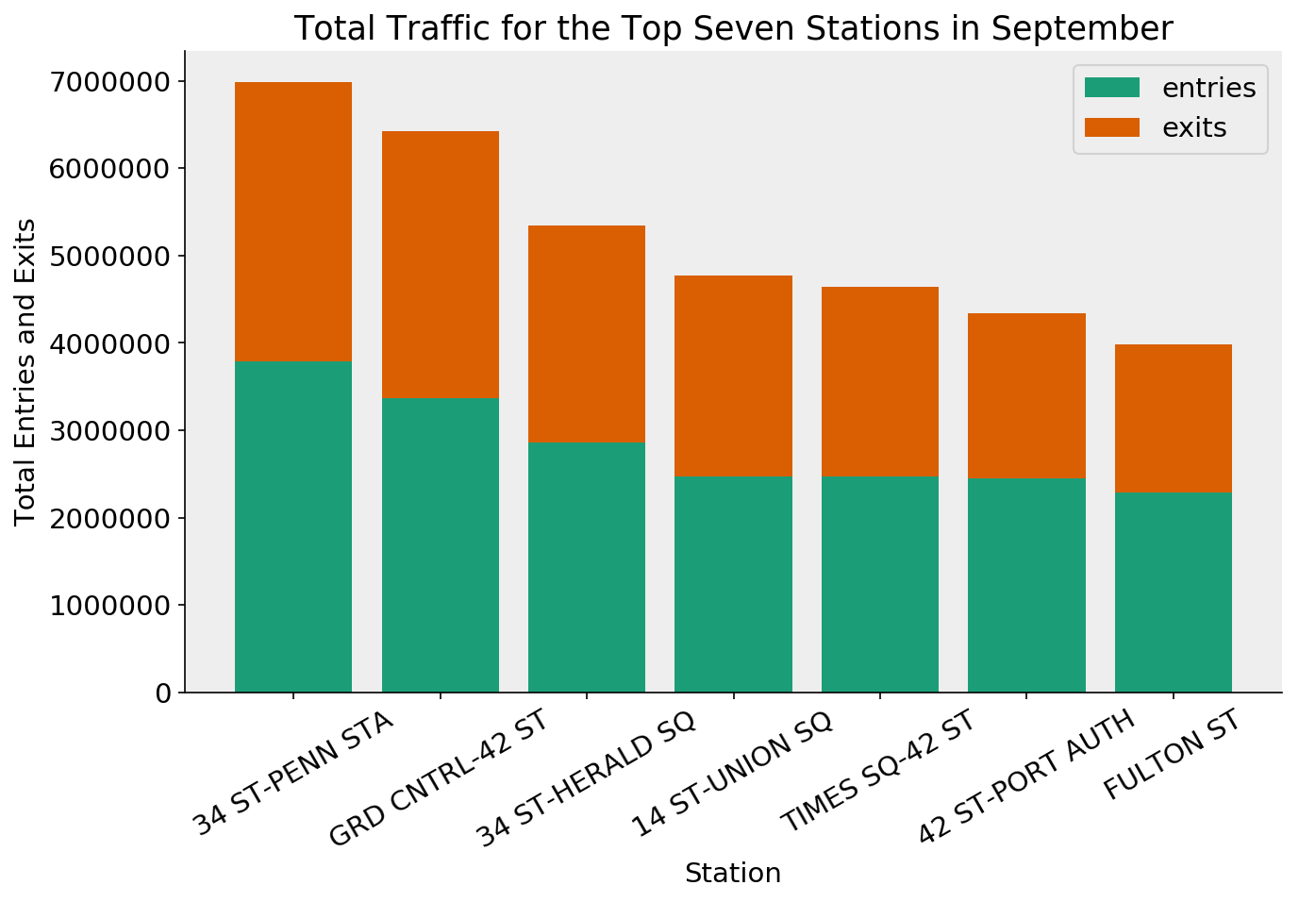
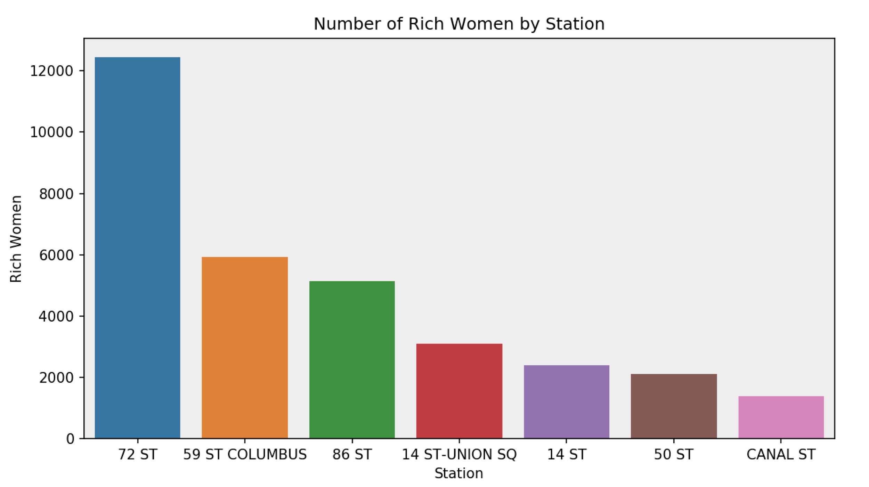
Results
Notes:
Aaron
Top Stations by Traffic
Weekday vs Weekend Traffic Hourly Analysis
Top Stations by Demographic
Concentrations of rich women by station
Most trafficked doesn’t intersect
with demographically-optimal
Must allocate to finding donors/attendees

Slide 12
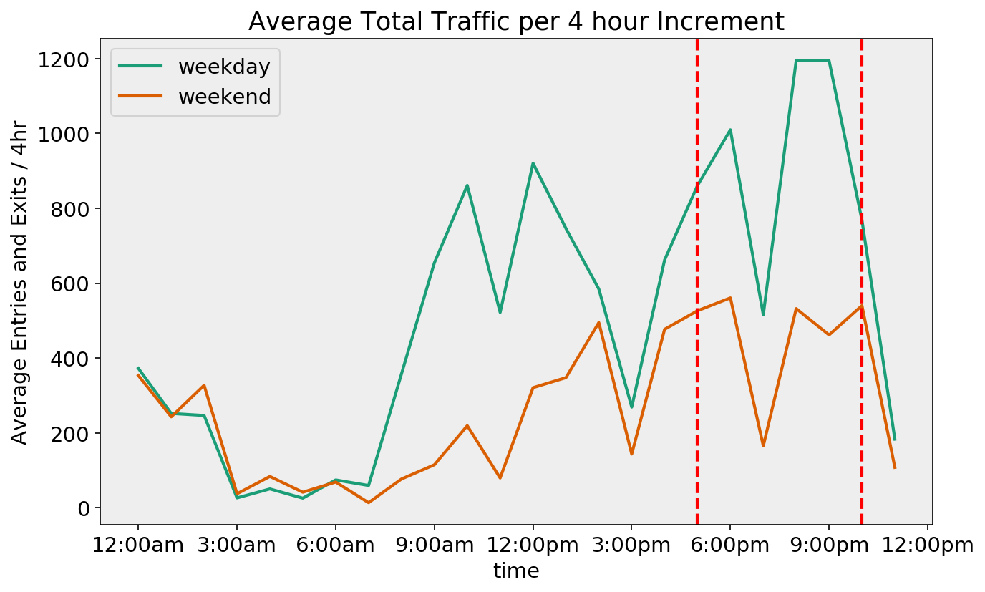
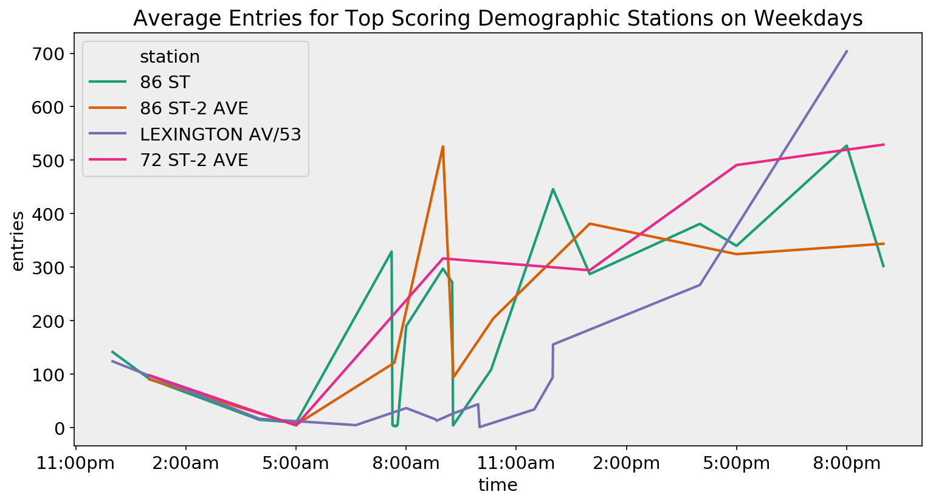
Results
Best Time of Day
Optimal window for marketing is between 5 and 10 PM
Best Day of Week
Monday through Thursday have max traffic
For traffic, M-Th > F > Sa-Su = Holidays
Notes:
Aaron

Slide 13
Conclusion
Our Recommendations:
Target ‘Donation’ Stations from 7:30AM to 10AM
86th St, 86th St-2nd Ave, Lexington Ave-53, 50th St, 72nd St-2nd Ave
Target ‘Attendance’ Stations from 5PM to 10PM
34th St-Penn Station, Grand Central Station-42nd St, 34th St-Herald Sq, 14th St-Union Sq, Times Sq-42nd St
Notes:
Ken
Our recommendations are twofold
Target specific stations for Donations
Target specific stations for filling attendance.
NO significant overlap between optimal demographic and highest traffic stations
Also a balanced approach will allow the chance to engage as many potential donors as possible, followed by the need to gain exposure and attendees.

Slide 14
Future Work/Next Step
Additional Data we want to gather or analyze to improve this study
Perform similar analysis on adjacent months and previous years to identify ridership trends
Station Entrance/Exit analysis
Household Density Analysis
Locations of high-volume tech spots in NYC
Notes:
Medford

Slide 15
Appendix

Slide 16
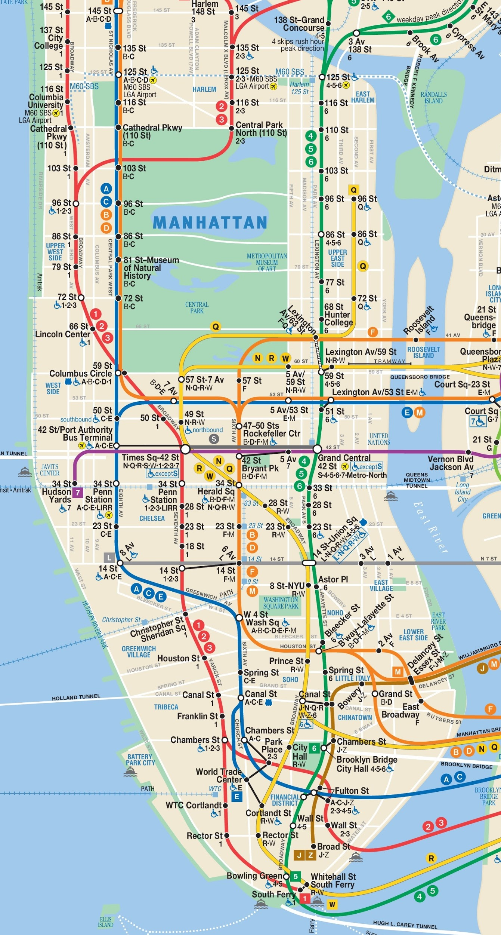
Notes:
Ken

Slide 17
Data Cleaning Methods
Reverse Counters
The change in values was reversed (*-1)
Data points that were too far apart
Removed anomalies in entry/exit
Duplicate data
Removed duplicates
Inconsistent Data: i.e. sta names do not match
Removed inconsistencies

Slide 18
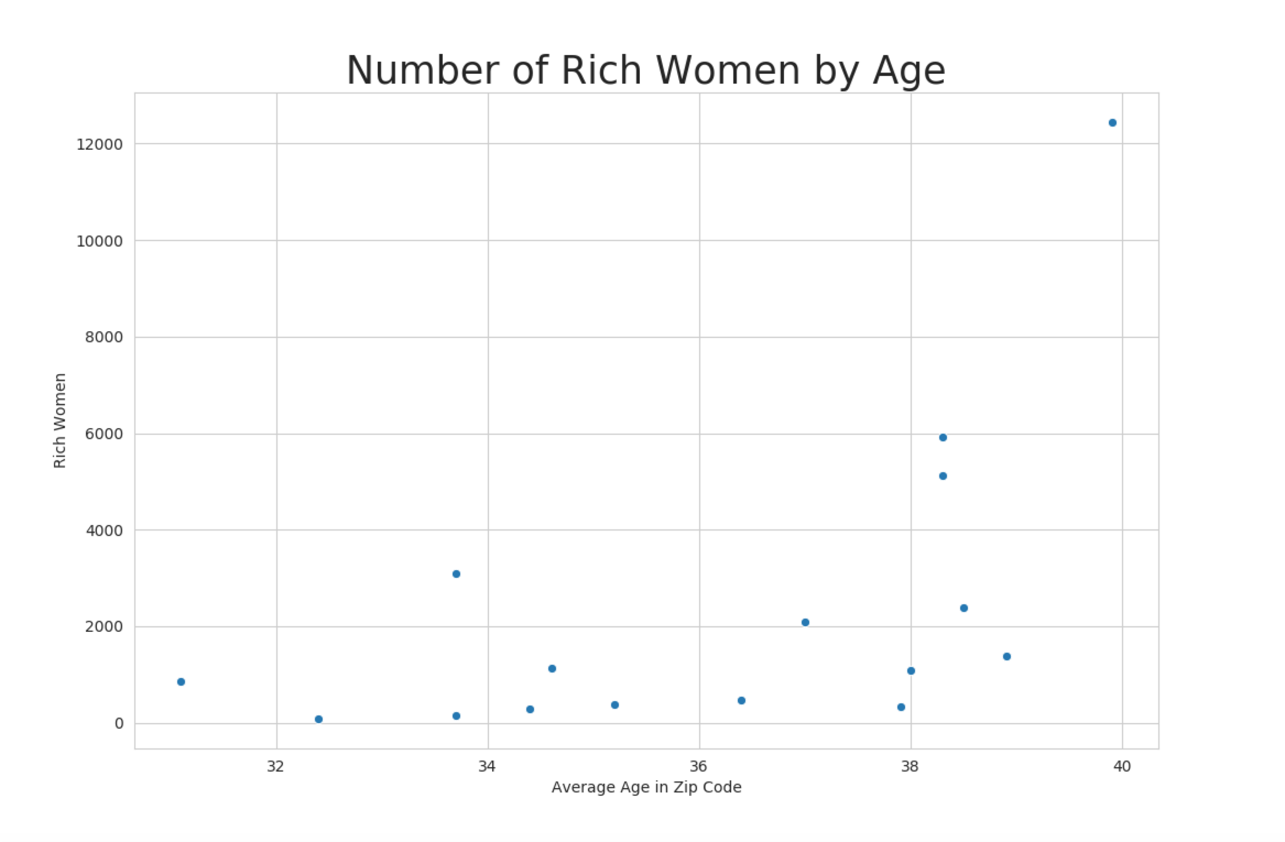
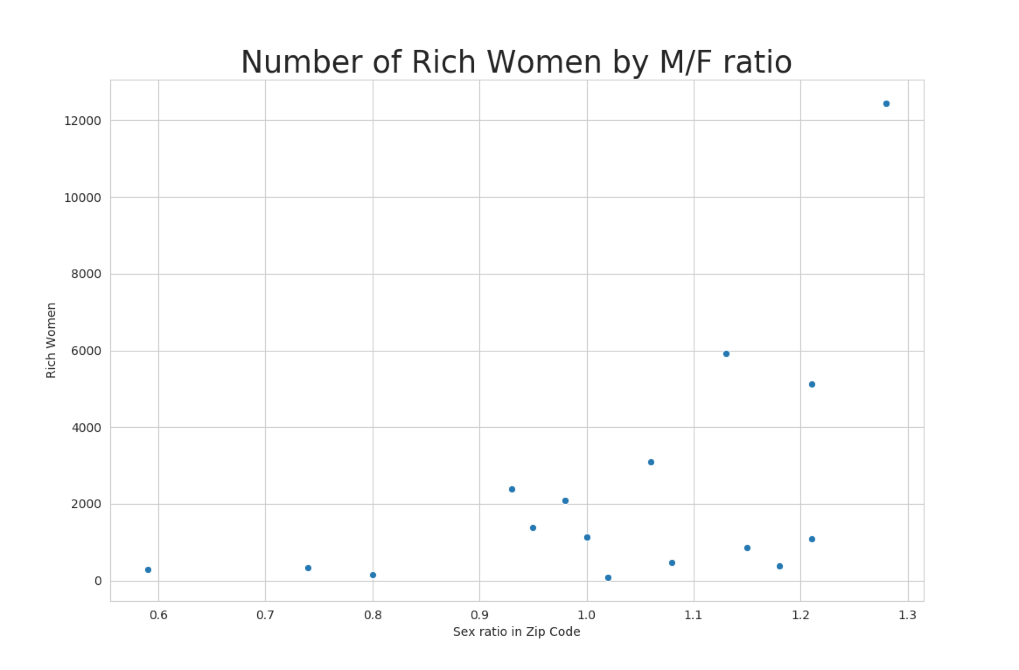
Finding the right location for WTWY donors

